Slide 1
The Financial Impact of Sustainability Commitments
By: Sara Stewart

Slide 2
Introduction
What I’m Asking:
Do sustainability commitments impact financial performance or consumer interest?
Why It Matters:
Fashion brands face pressure for transparency — but do commitments actually accomplish anything measurable?

Slide 3
Sustainability Commitments
What are “sustainability commitments”?
H&M – “Conscious Collection”
Burberry – “ReBurberry Edit”
Adidas – Launched FUTURECRAFT.LOOP
Lululemon – “Earth Dye Collection”
Columbia – “OutDry Collection”

Slide 4
Literature Review
What Research Shows:
Sustainability might improve brand reputation
Financial effects are inconsistent
Online visibility effects are understudied
Key Gaps:
Few causal studies in fashion
Almost no use of Google Trends
Rarely compare treated vs matched control brands

Slide 5
Data Collection
Data Sources:
Revenue & stock data: corporate filings + Yahoo Finance
Consumer interest: Google Trends
Sustainability data: FTI reports + Good On You
Sample: 5 treated brands matched with 5 controls 6-year window (–3 to +3 relative to commitment)

Slide 6
Comparison Brands
Adidas →
Burberry →
H&M →
Lululemon →
Columbia →
Under Amour
Ralph Lauren
Next plc
Nike
Canada Goose

Slide 7
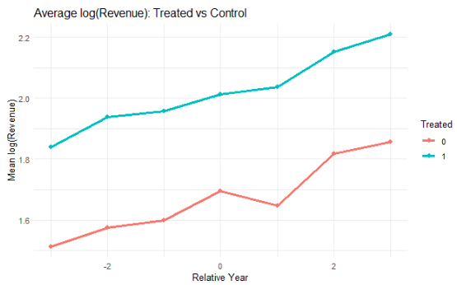
Descriptive Statistics - Revenue
Treated brands start higher
Both groups grow over time
Treated show a dip at Year 0

Slide 8
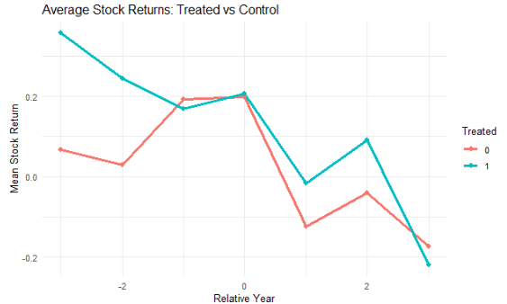
Descriptive Statistics - Stock
Large pre-treatment volatility
Drop appears in both groups

Slide 9
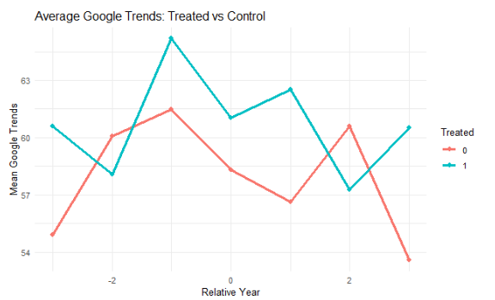
Descriptive Statistics – G Trends
Similar patterns
Treated brands slightly higher
No consistent rise after commitments

Slide 10
Methods
Brand Matching to Comparable Control (PSM)
Check pre-treatment similarity (t test)
Estimate causal effects (DiD)
Track year-by-year impacts (Event Study)

Slide 11
Results
Matched-Pair Differences:
Revenue: β = -1.035, p = .69
Stock: β = 0.097, p = .12
Google Trends: β = 2.798, p = .16
Difference-in-Differences:
Revenue: β = .096, p = .64
Stock: β = −.23, p = .77
Google Trends: β = .59, p = .88

Slide 12
Event-Study Interpretation
Revenue
Relative Year | Estimate | P - value
- 3 | - 0.1866 | 0.2155
- 2 | - 0.1938 (17.62%) | 0.0313 *
0 | - 0.0775 | 0.5372
1 | - 0.2116 (19.07%) | 0.0461 *
2 | 0.5758 (77.86%) | < 0.0001 ***

Slide 13
Event-Study Interpretation
Stock
Relative Year | Estimate | P - value
- 3 | 0.3430 | 0.3097
- 2 | - 0.8900 | 0.1777
0 | - 0.1692 | 0.7883
1 | - 1.2231 | 0.1241
2 | - 1.4566 (76.70%) | 0.0061 **

Slide 14
Event-Study Interpretation
Google Trends
Relative Year | Estimate | P - value
- 3 | - 2.4420 | 0.4556
- 2 | - 4.2330 | 0.1222
0 | - 3.9176 | 0.2493
1 | - 2.9795 | 0.2659
2 | - 4.8782 | 0.98472

Slide 15
Conclusion
Conclusion:
No short-term effects
Medium-term effects inconsistent
Search interest unaffected
Future Work:
Larger brand samples
Specific consumer interest measures
Examine types of sustainability initiatives

Slide 16
Special Thanks
Dr Haimeng Zhang
UNC at Greensboro
Faculty and Staff in the Math Department

